Slide 1
CS555 Final Project
Linear Regression Research
Yi Lee (Kyle)

Slide 2

Data set Overview
Energy Efficiency Data Set

Slide 3
Data set Overview
768 data rows
Column
Relative Compactness
Surface Area
Wall Area
Roof Area
Overall Height
Orientation
Glazing Area
Glazing Area Distribution
Target Parameter: Heating Load

Slide 4

Data Reduction
Based on Residuals

Slide 5
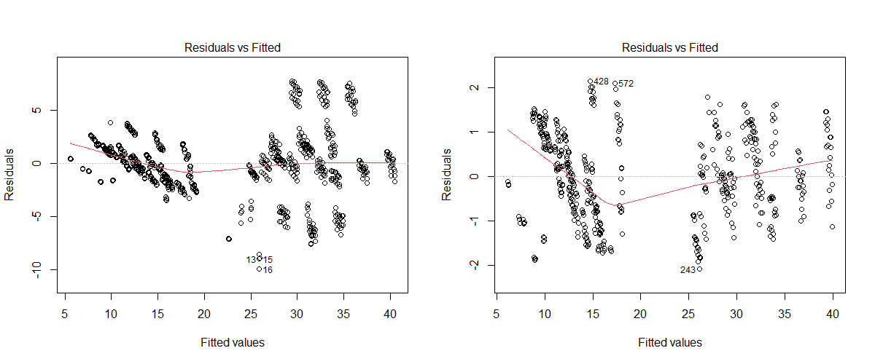
Data Reduction
From 768 to 500

Slide 6

Research Question
3 Questions

Slide 7
Q1: Performance Improvement by Data Reduction

Slide 8

Result
 | Adj. R-Squared | Residual SE | RSS
Before | 0.91 | 2.93 | 6543
After | 0.99 | 0.96 | 454
Model:
Y = X1+X2+X3+X4+X5+X6+X7+X8

Slide 9

Q2: Human Selected

Slide 10
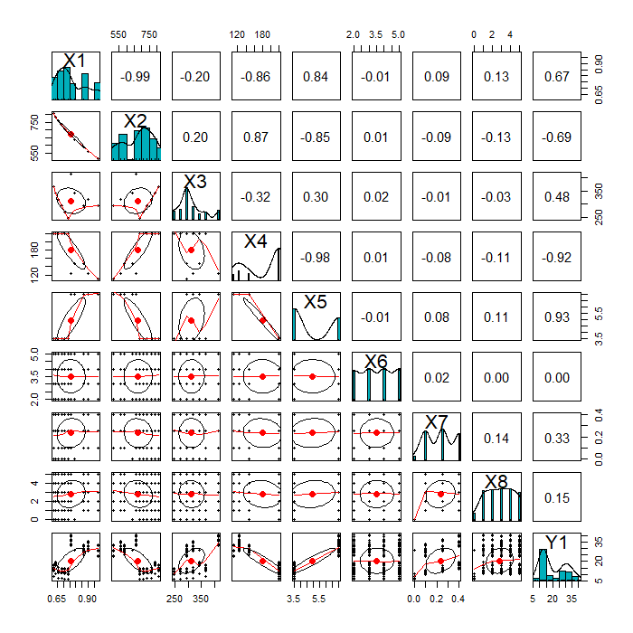
Correlation Plot
F-Test
Null: R = 0
X6 Fail to Reject
X7 Reject
X8 Reject
Strategy
Drop X6

Slide 11
Correlation Plot
X1 - X2 Highly Correlated
Drop X2
X4 - X5 Highly Correlated
Drop X5

Slide 12
Result
 | Adj. R-Squared | Residual SE | RSS
Before | 0.91 | 2.93 | 6543
After | 0.99 | 0.96 | 454
Human | 0.97 | 1.45 | 1042
Model:
Y = X1+X3+X4+X7+X8

Slide 13

Backward and Forward Selection

Slide 14

Selection Result
Backward:
Y = X1 + X2 + X3 + X5 + X7 + X8
Forward:
Y = X1 + X3 + X4 + X5 + X7 + X8

Slide 15

Conclusion
Five Models Performance

Slide 16
Comparison
 | Adj. R-squared | Residual SE | RSS
RawData | 0.9154 | 2.934 | 6543.76
AfterReduction | 0.9903 | 0.961 | 454.38
MySelection | 0.9777 | 1.452 | 1042.03
mForward | 0.9903 | 0.961 | 455.225
mBackward | 0.9903 | 0.961 | 455.225

Slide 17
Last Word
Don’t trust your personal decision
Trust the algorithm

